Slide 1
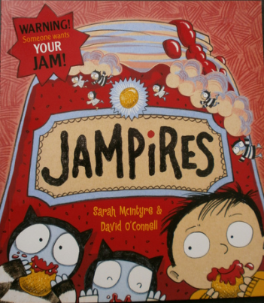
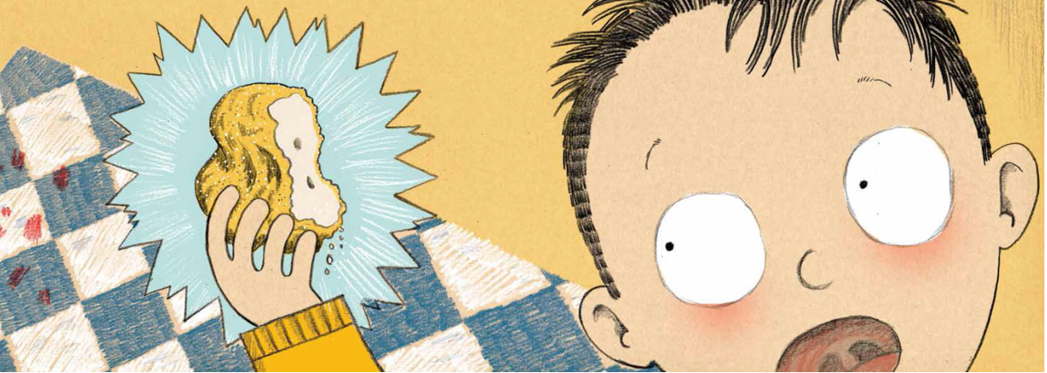
Our English topic this week is all about the text Jampires. If you haven’t already, tune into the Gordonbrock YouTube channel and listen to the story. It really is a JAM-TASTIC book.
This week, we will be focussing on writing instructions. The Jampires want to make their own delicious jam dessert but they don’t know how to. Your mission is to write a jam-tastic set of instructions for the Jampires. It can be a recipe you’ve made before or a made up one. Our only wish is that it contains Jam!

Slide 2
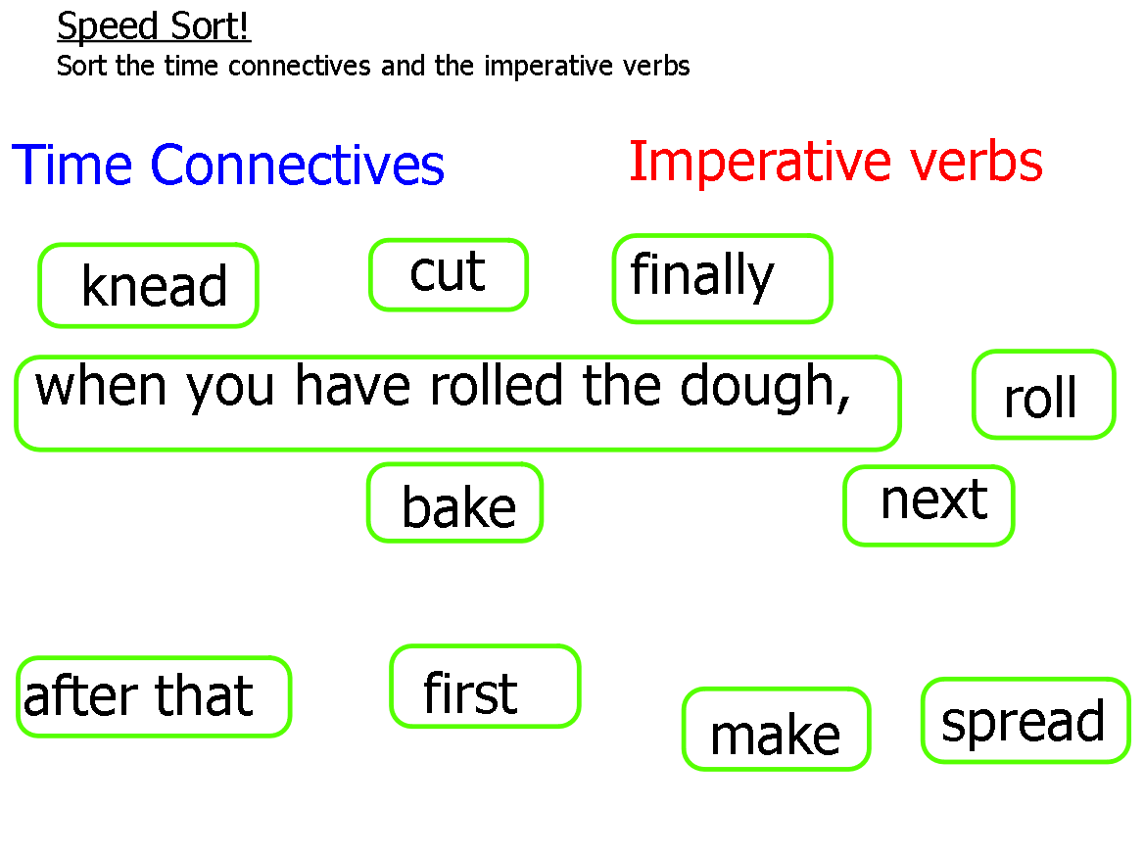
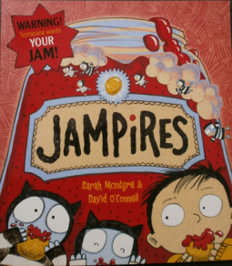
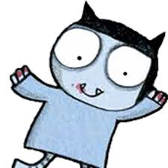
To warm up our brains…
Imperative verbs are also known as ‘bossy verbs’ because they tell people what to do!
E.g. shut the door or turn on the kettle
Time connectives are words that join phrases or sentences together to help us
understand when something is happening

Slide 3
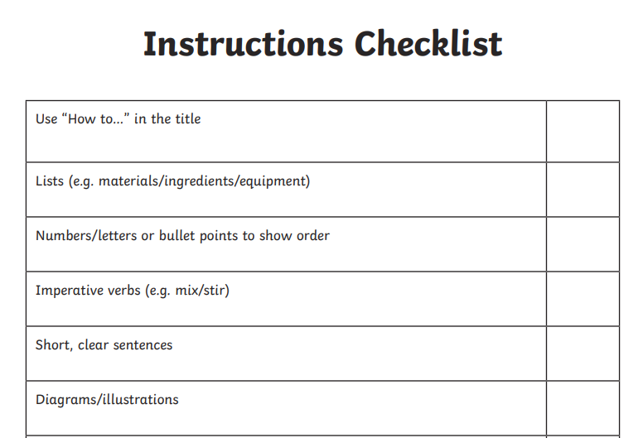
Can you read through the instructions and identify the key features? Use the checklist to help you
OPTIONAL –
Make the Jampire Jam Tarts

Slide 4
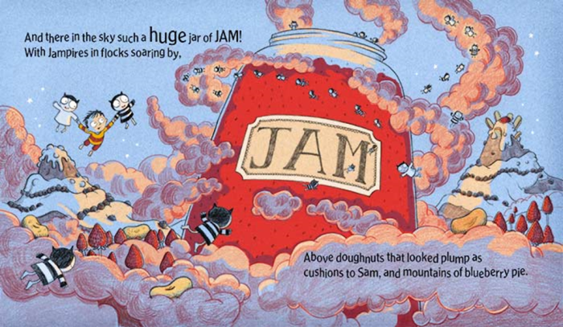
Hi Year 3,
As you know, we love all kinds of jammy food and have decided to open a jam restaurant!
We can't wait to finalise the new menu for the JAMporium.
We've got a few ideas, but need your help to design and write some new recipes for our new menu.
Please help!
Thank you,
The Jampires

Slide 5
Design a delicious jam based dessert

Slide 6
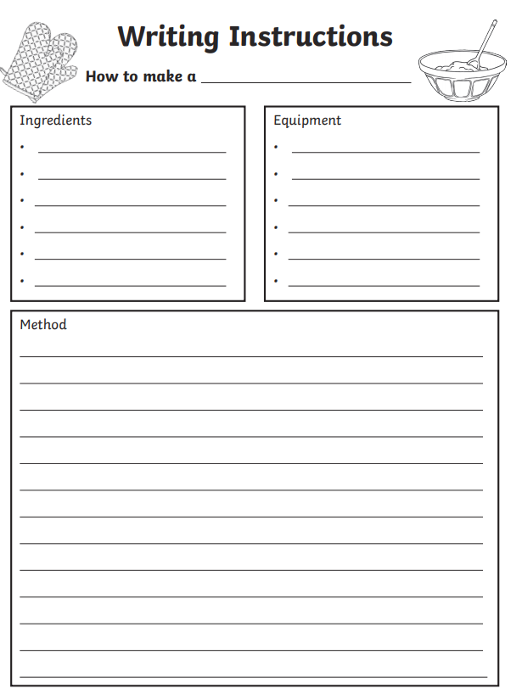
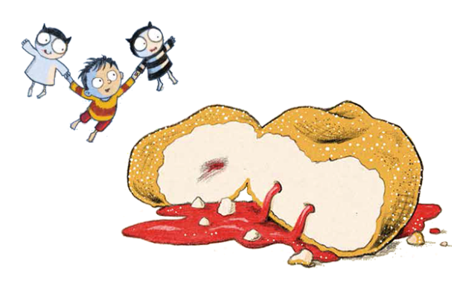
The Jampires now need your recipe! Use the instructions checklist and word mat to help you write a set of instructions. Your instructions should look similar to this layout

Slide 7
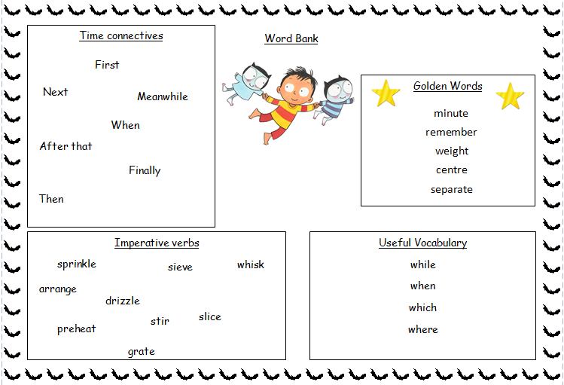

Slide 8
Now it’s your turn to be the teacher!
Mrs Barber has written some instructions on how to make beeswax wraps. Can you read it and check if she has used all the correct features? Did she include time connectives and imperative verbs? Look on the next three pages to mark Mrs Barber’s work…

Slide 10
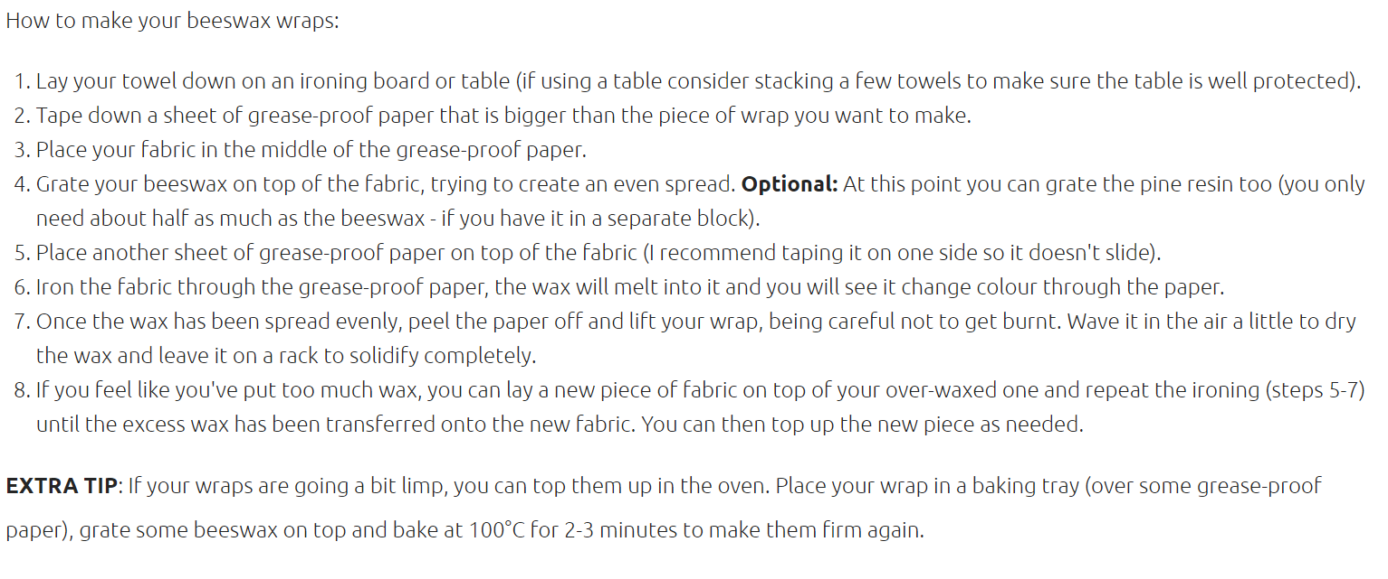
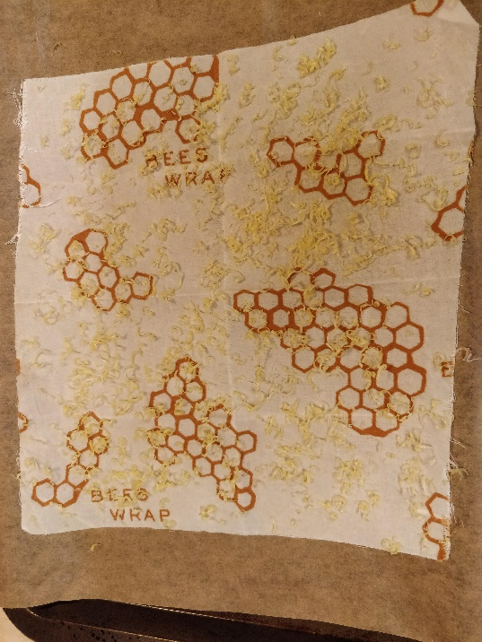
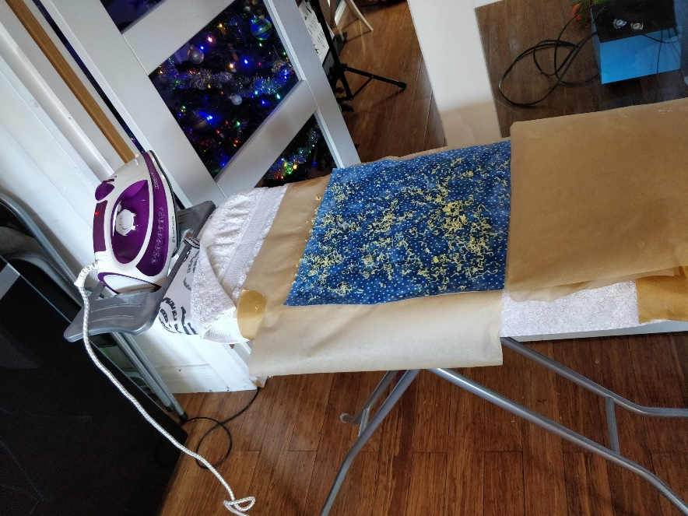

Slide 12
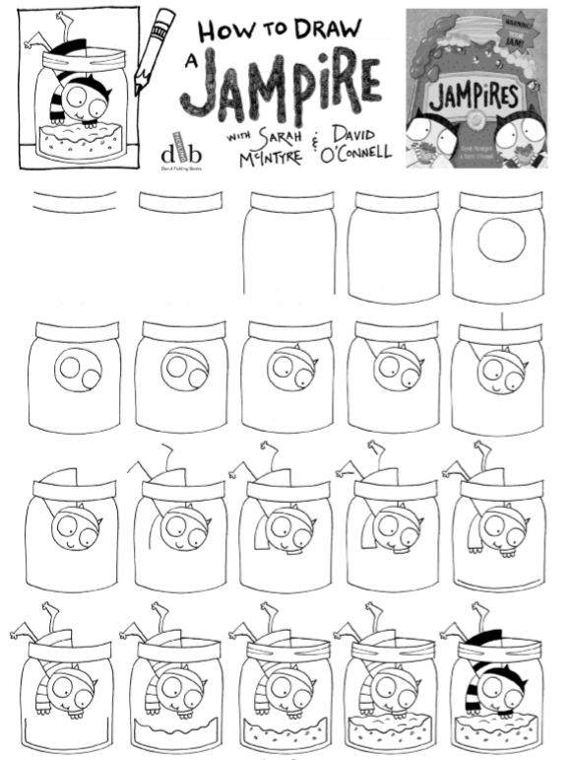
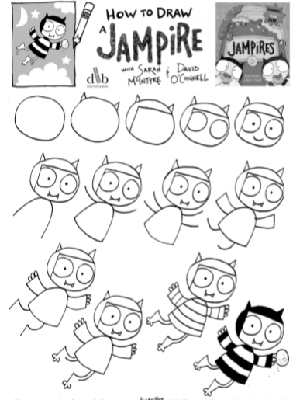
Just for fun….

